Slide 1
Machine Learning DSECL ZG565
ML Team

Slide 2
Lecture No. – 3 | Bayesian Learning
Dates: 20th and 21st November 2021

Slide 3
Session Content
Bayesian learning
Basics (T1 book by Tom Mitchell - 6.1)
Bayes Theorem (T1 book by Tom Mitchell - 6.2)
MAP Hypothesis (T1 book by Tom Mitchell - 6.3)
MLE Hypothesis (T1 book by Tom Mitchell - 6.4)
Minimum Description Length (MDL) principle
(T1 book by Tom Mitchell - 6.6)

Slide 4
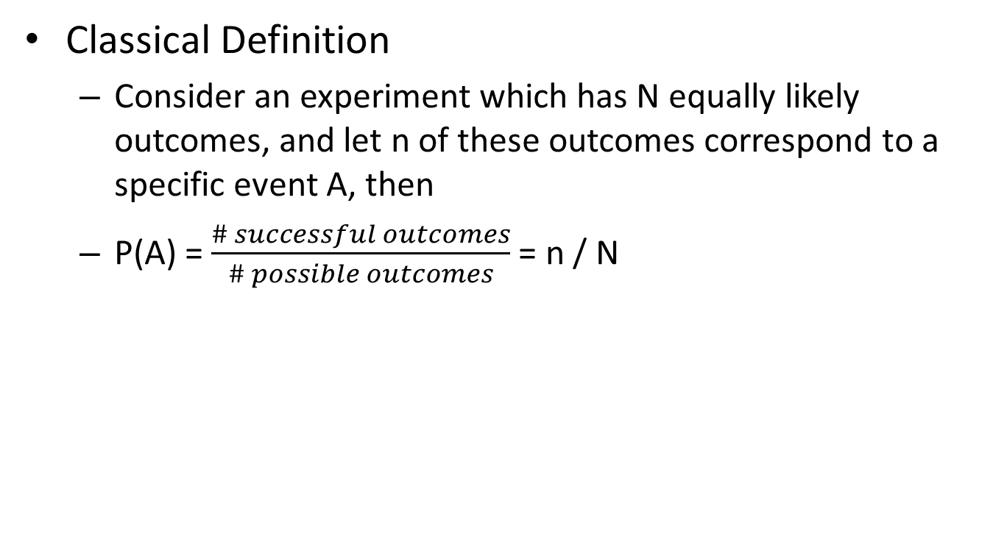
Probability Theory
Classical Definition
Consider an experiment which has N equally likely outcomes, and let n of these outcomes correspond to a specific event A, then
P(A) = $\frac{\# successful outcomes}{\# possible outcomes}$ = n / N
Images taken from “Probabilistic Graphical Models” by David Sontag

Slide 5
AXIOMS of Probability Theory
A probability p(ω) for each outcome ω must satisfy the following axioms
Images taken from “Probabilistic Graphical Models” by David Sontag

Slide 6
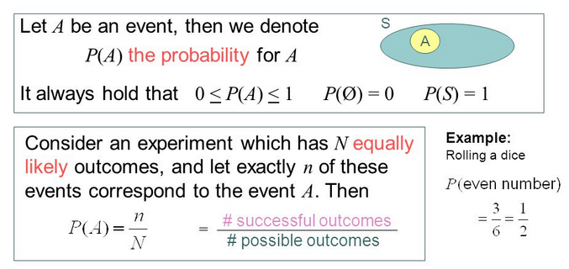
Probability Theory

Slide 7
Random Variable
A random variable, usually written X, is a variable whose possible values are numerical outcomes of a random phenomenon or experiment.
Examples
X = number of heads when the experiment is flipping a coin 20 times.
C = the daily change in a stock price.
R = the number of kilometers per litre you get on your car during a family vacation.

Slide 8
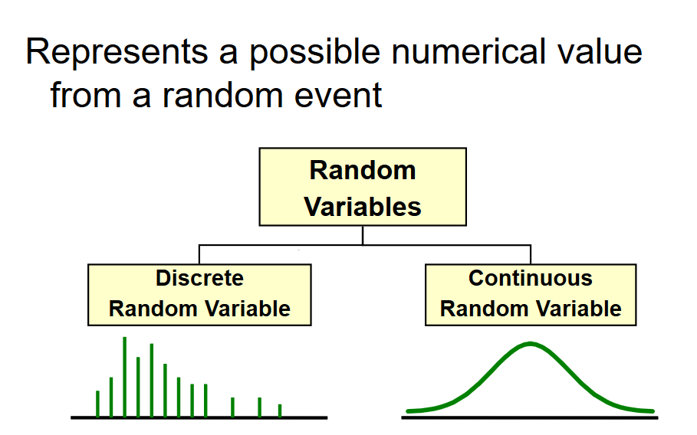
Random Variable

Slide 9
Random Variable
Discrete Random Variable
one that takes on a countable number of values
usually count data [Number of]
list all possible outcomes without missing any of them
Example:
X = sum of values on the roll of two dice:
X has to be either 2, 3, 4, …, or 12.
Y = number of students in MTech DSE:
Y has to be 60,65,70 …………

Slide 10
Random Variable
Continuous Random Variable
Variable that takes on an uncountable number of values
Usually measurement data [time, weight, distance, etc]
You can never list all possible outcomes even if you had an infinite amount of time
Example:
X = time it takes you to drive home from work place: X > 0, might be 30.1 minutes measured to the nearest tenth but in reality the actual time is 30.10000001…………………. minutes?)
Exercise: try to list all possible numbers between 0 and 1

Slide 11
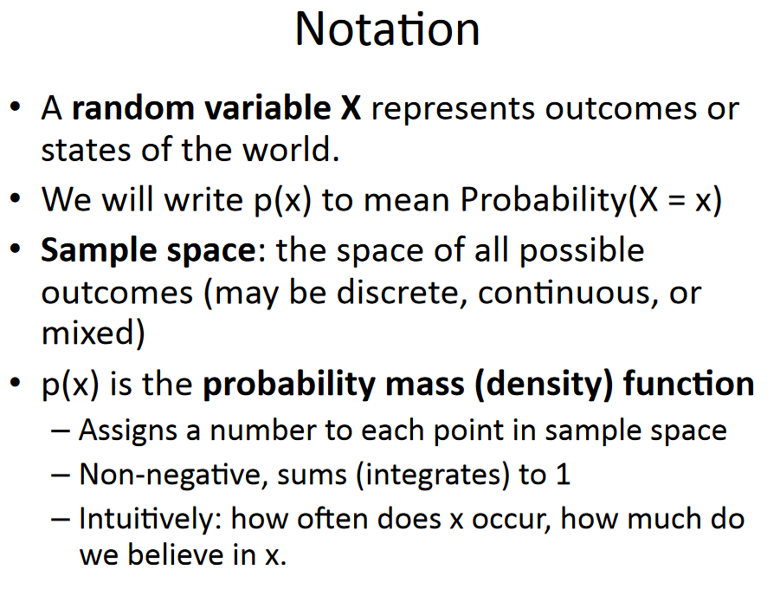
Random Variable

Slide 12
Probability Distributions
The outcomes for random variables and their associated probabilities can be organized in to distributions
Two types of distributions based on types of Random variables: Discrete and Continuous
Discrete:
Binomial, Poisson, Geometric distributions
Continuous
Gaussian, exponential, t, F, chi-squared distributions

Slide 13
Describing distributions
One way is to construct a graph and analyze the graph to make inferences
Discrete: Prob Mass Function (pmf), Cumulative density function
Continuous: prob density function (pdf)
Mean, variance and standard deviations to represent the entire distribution

Slide 14
Bernoulli Distribution
A r.v. X is said to follow Bernoulli’s distribution when there are only two possible outcomes
By convention either Success (1) or Failure (0)
And there is only one trial
Ex: tossing a coin at the start f the match
Let p represents the probability of success and (1-p) represent the probability of failure, then the probability mass function is defined as
f(x) = p if x=1
1-p x=0
p^{x} (1-p)^{(1-x)}

Slide 15
Binomial Distribution
Again binary outcomes, but for n independent trials
Probability of success (p) remains the same for all the trials
Probability of r success is given by
P(X=r) = ^{n}C_{r} p^{r} (1-p)^{n-r}
Mean E(X) = np
Variance Var(X) = npq (where q=1-p)

Slide 16
Estimate Probabilities from Data
For continuous attributes:
Probability density estimation:
Assume attribute follows a normal distribution
Use data to estimate parameters of distribution (e.g., mean and standard deviation)
Once probability distribution is known, use it to estimate the conditional probability P(X_{i}|Y)
Slide adopted from “Introduction to Data mining” Vipin Kumar

Slide 17
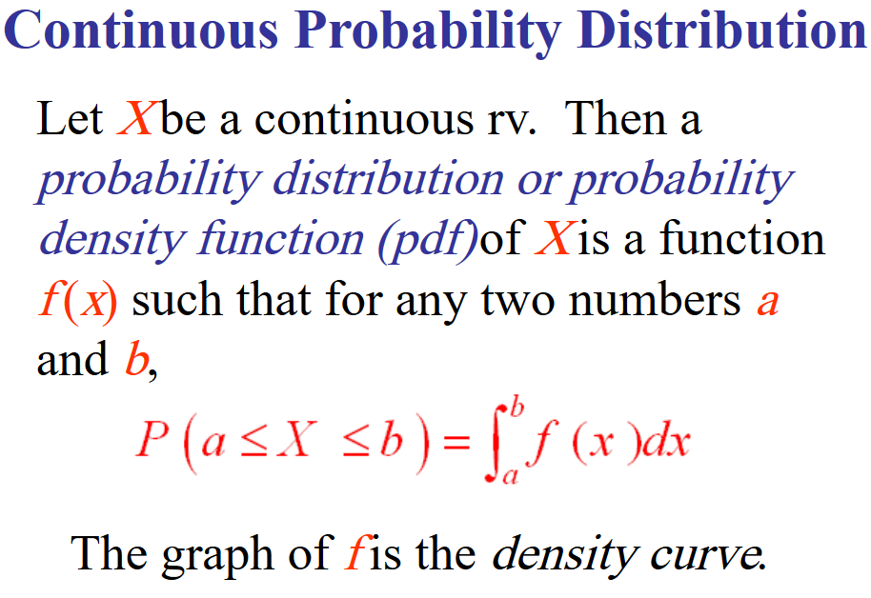
Probability Densities

Slide 18
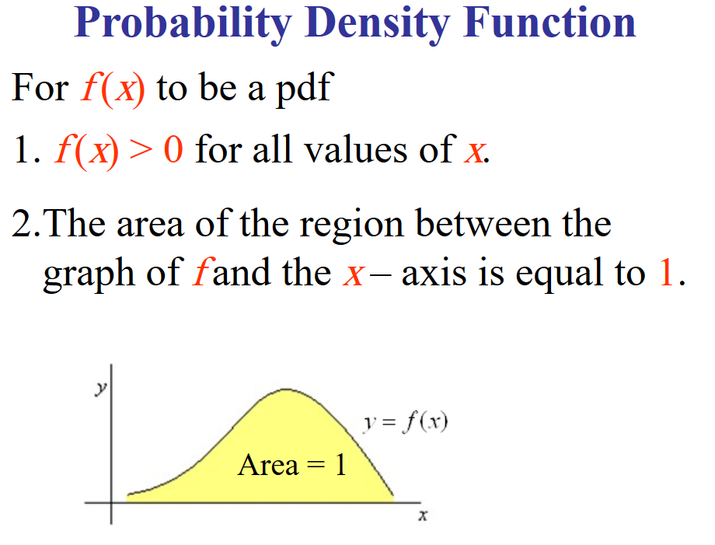
Probability Densities

Slide 19
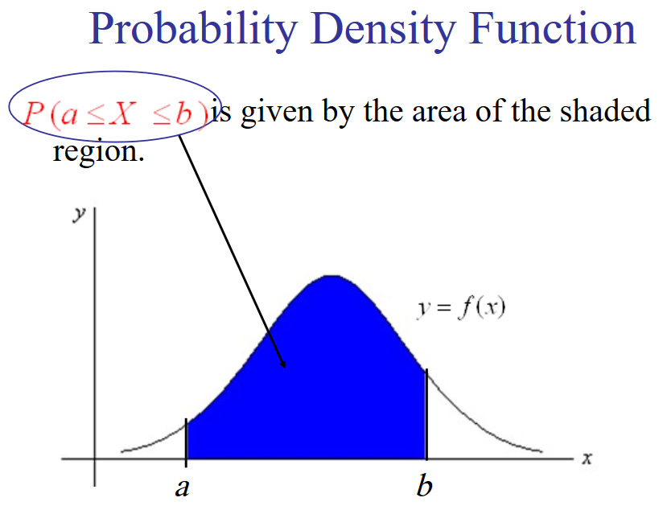
Probability Densities

Slide 20
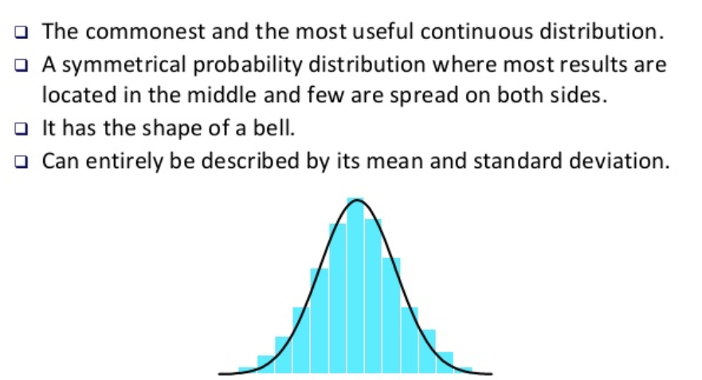
Gaussian Distribution

Slide 21
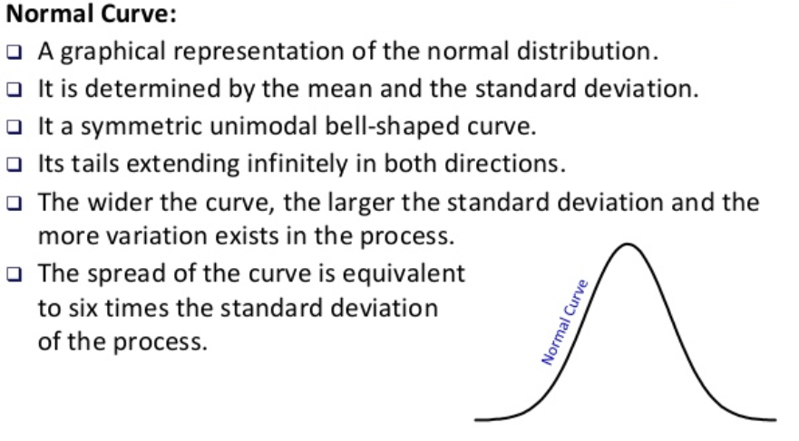
Gaussian Distribution

Slide 22
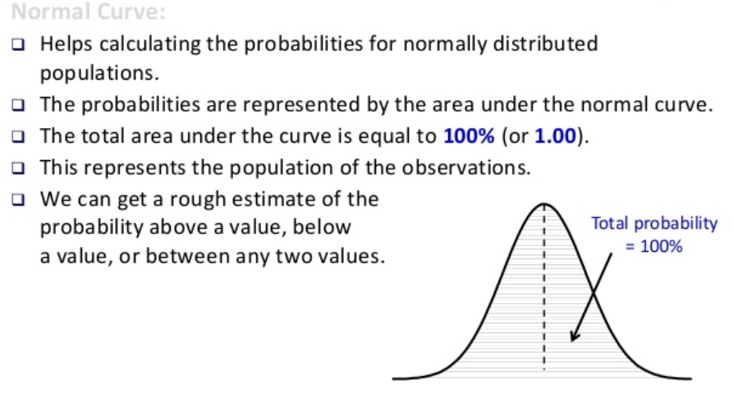
Gaussian Distribution

Slide 23
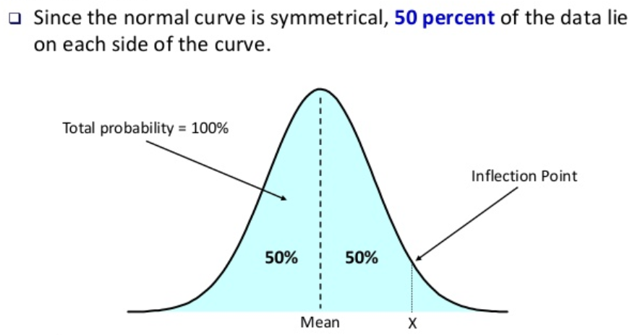
Gaussian Distribution

Slide 24
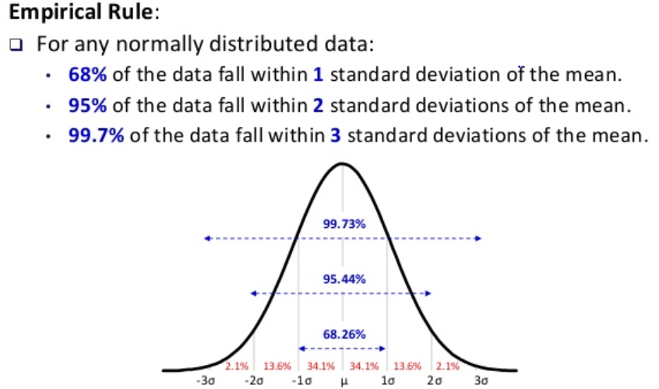
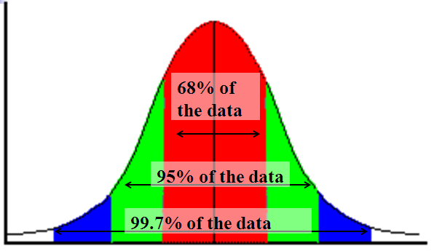
Gaussian Distribution

Slide 25
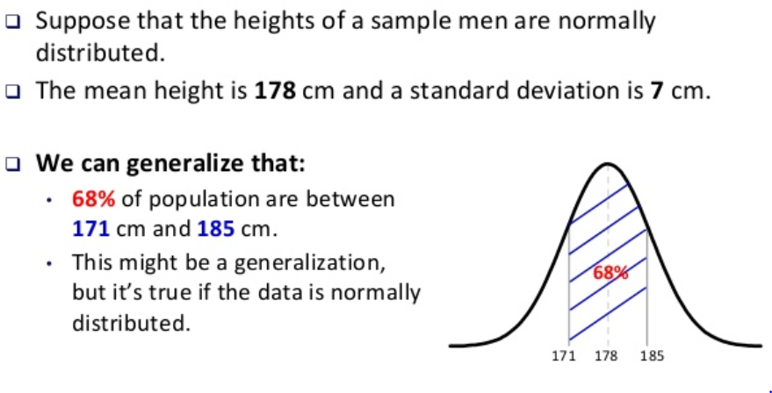
Gaussian Distribution

Slide 26



Mean, Variance & Standard Deviation
The mean of a discrete random variable is the weighted average of all of its values. The weights are the probabilities.
This parameter is also called the expected value of X and is represented by E(X).
The variance is
The standard deviation is

Slide 27
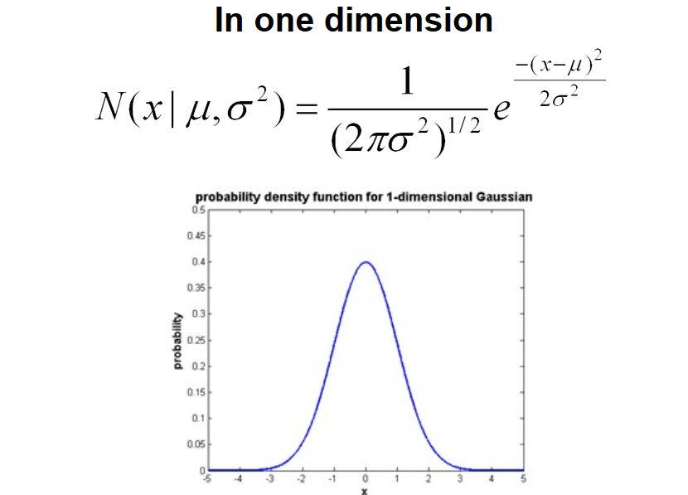
Gaussian Distribution

Slide 28
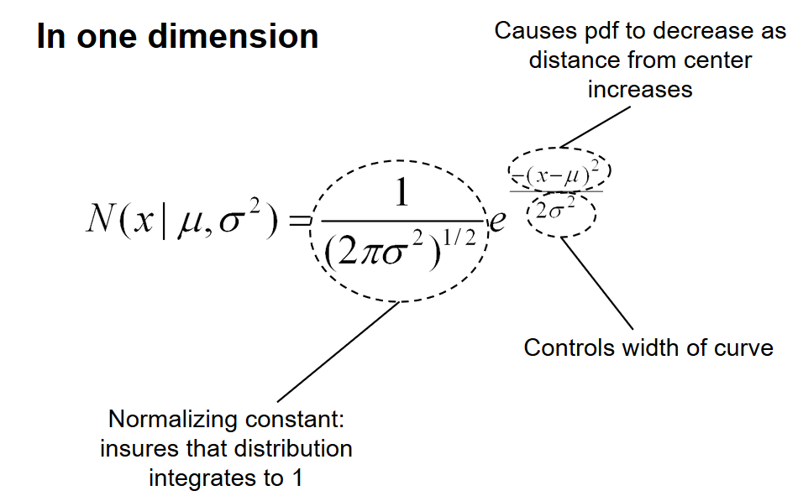
Gaussian Distribution

Slide 29
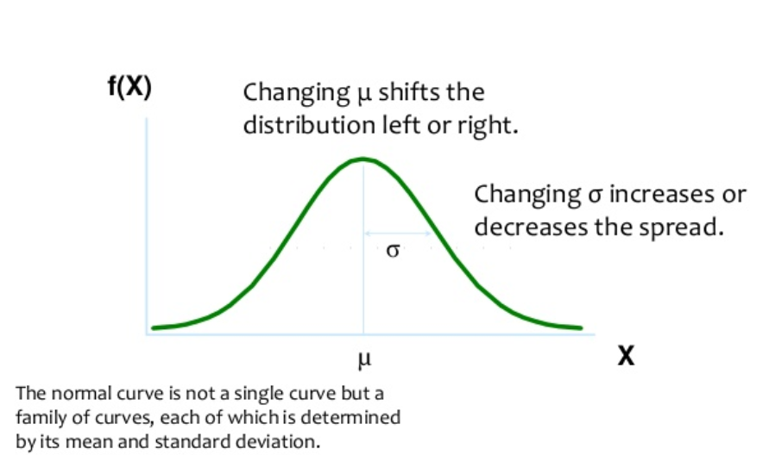
Gaussian Distribution

Slide 30
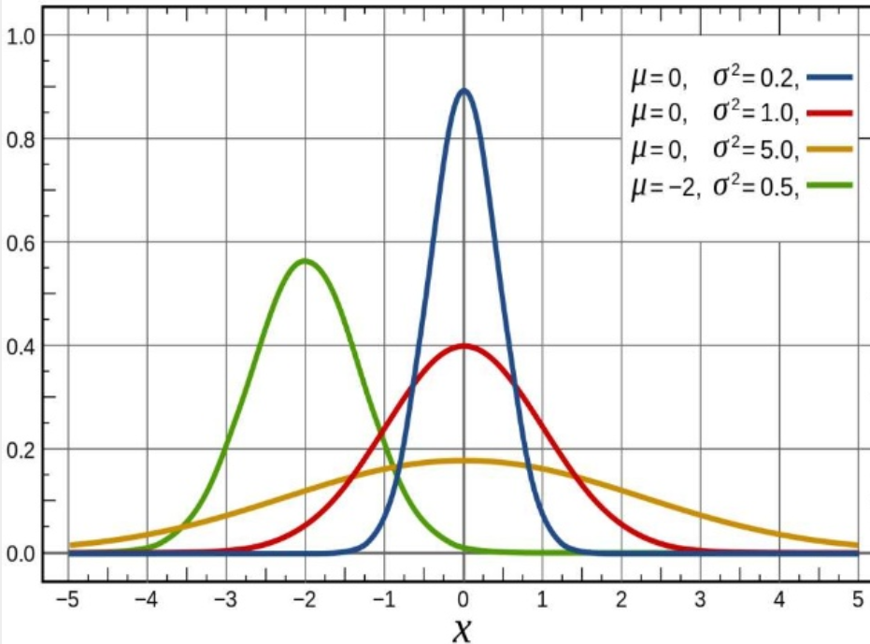
Gaussian Distribution

Slide 31
Estimate Probabilities from Data
Normal distribution:
One for each (X_{i},Y_{i}) pair
For (Income, Class=No):
If Class=No
sample mean = 110
sample variance = 2975
Slide adopted from “Introduction to Data mining” Vipin Kumar

Slide 32
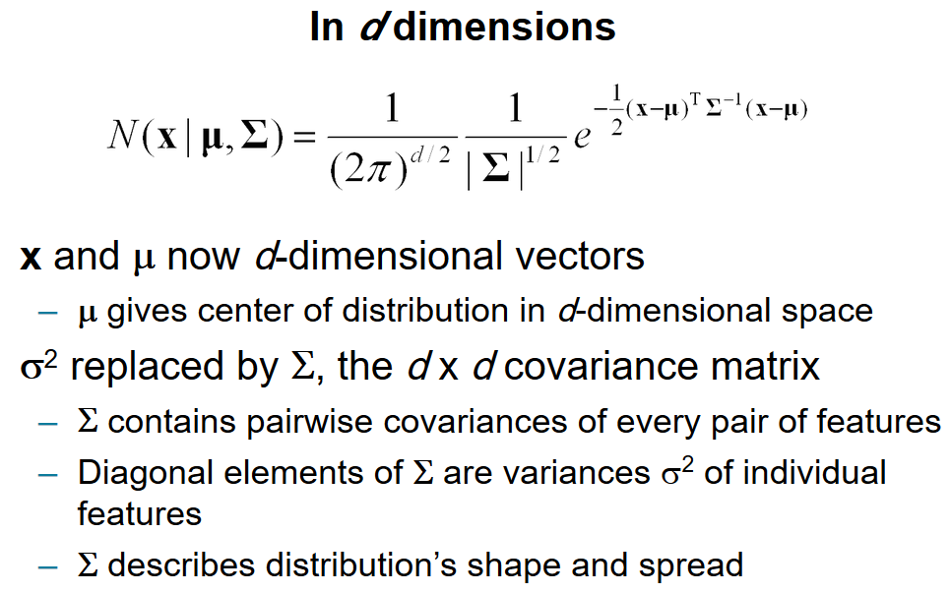
Multivariate Gaussian Distribution

Slide 33
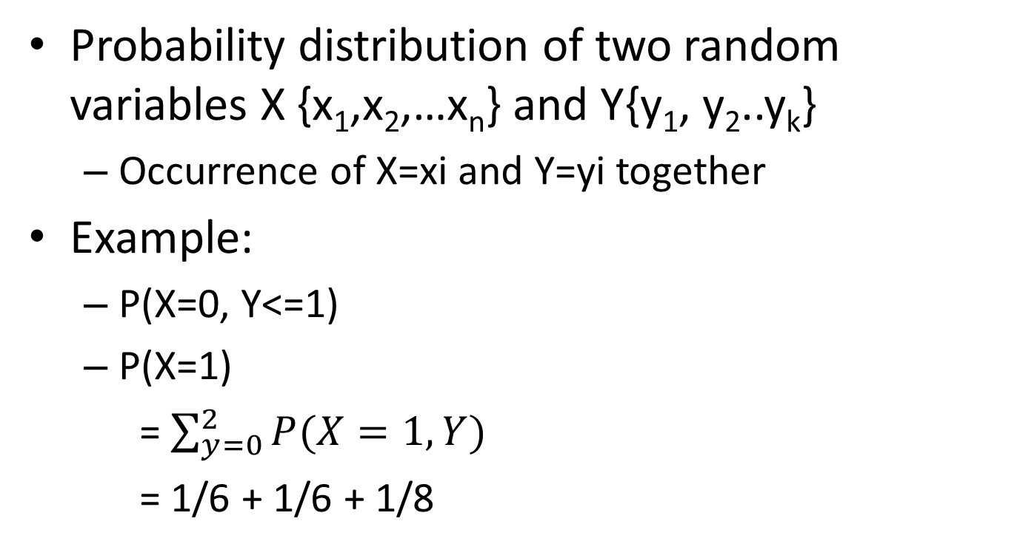
JOINT Distributions
Probability distribution of two random variables X {x₁,x₂,…x_{n}} and Y{y₁, y₂..y_{k}}
Occurrence of X=xi and Y=yi together
Example:
P(X=0, Y<=1)
P(X=1)
= $\sum_{y=0}^{2}{P(X=1,Y)}$
= 1/6 + 1/6 + 1/8
Y
0
1
2
0
1/4
1/6
1/8
X
1
1/6
1/6
1/8

Slide 34
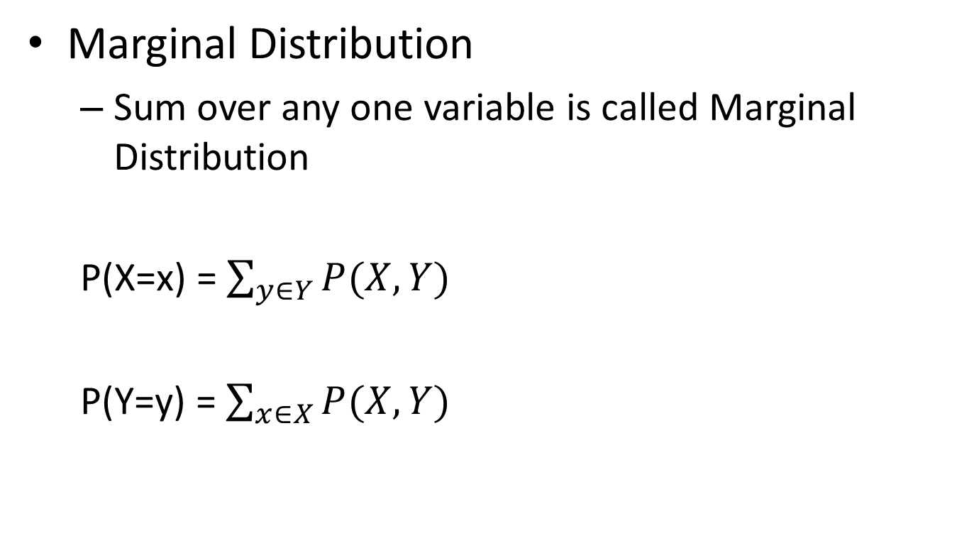
JOINT Distribution
Marginal Distribution
Sum over any one variable is called Marginal Distribution
P(X=x) = $\sum_{y∈Y}{P(X,Y)}$
P(Y=y) = $\sum_{x∈X}{P(X,Y)}$

Slide 35
Conditional Probability
Estimating probability for two or more related events
Measure influence of one variable over another
Let A and B be two events, p(B) > 0
p(A|B) = p(A ∩ B) / p(B)
Using random variable notations,
p(a|b) denotes the probability of A=a and B=b
i.e. p(A=a |B=b)

Slide 36


Basic Formulas for Probabilities
Product Rule: probability P(A ∧ B) of a conjunction of two events A and B:
P(A ∧ B) = P(A | B) P(B) = P(B | A) P(A)
Sum Rule: probability of a disjunction of two events A and B:
P(A ∨ B) = P(A) + P(B) - P(A ∧ B)
Theorem of total probability: if events A₁,…, A_{n} are mutually exclusive with , then

Slide 37
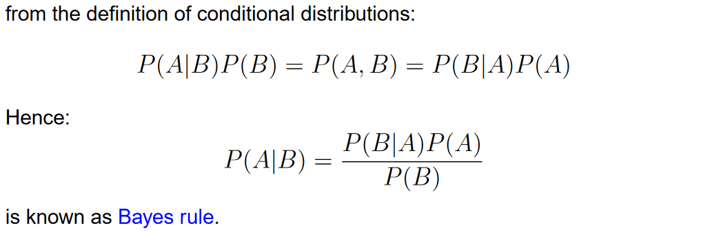
Bayes Rule

Slide 38
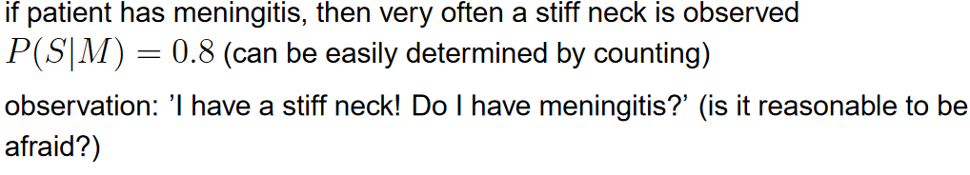
Bayes Rule Example 1
if patient has meningitis, then very often a stiff neck is observed

Slide 39
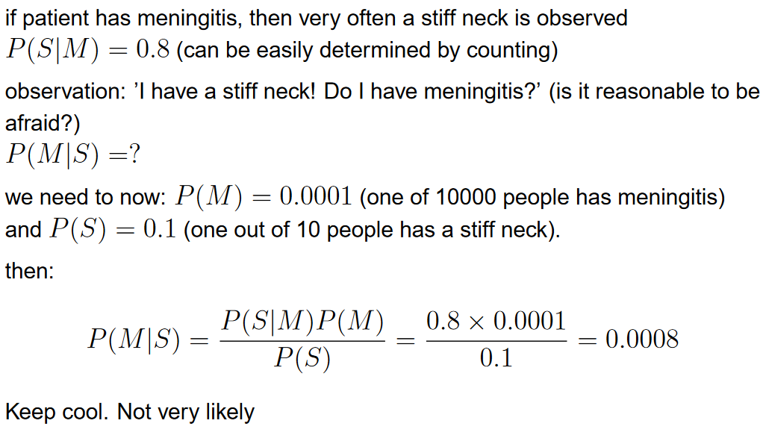
Bayes Rule Example 1
Bayes rule - Example

Slide 40
Bayes Rule Example 2
Does a patient have cancer or not?
The patient takes a lab test and the test returns a correct positive result in only 98% of the cases in which the disease is actually present
And a correct negative result in only 97% of the cases in which the disease is not present
Of the total population, only 0.008% has cancer

Slide 41
Bayes Rule Example 2
Given:
P(cancer) = P(¬cancer) =
P(+|cancer) = P(−|cancer) =
P(+|¬cancer) = P(−|¬cancer) =
Using Bayes Theorem:
P(cancer|+)= P(+|cancer) P(cancer) / P(+)
P(¬cancer |+)= P(+| ¬cancer) P(¬cancer) / P(+)
Since denominator is common
P(cancer|+) proportional to P(+|cancer) P(cancer)
P(¬cancer |+) proportional to P(+| ¬cancer) P(¬cancer)

Slide 42
Bayes Rule Example 2
P(cancer) = 0.008 P(¬cancer) = 1-0.008=0.992
P(+|cancer) = 0.98 P(−|cancer) = 0.02
P(+|¬cancer) = 1-0.97=0.3 P(−|¬cancer) = 0.97

Slide 43
Remember: Some terminology
Likelihood function: P(data | θ)
Prior: P(θ)
Posterior: P(θ | data)
Conjugate prior: P(θ) is the conjugate prior for likelihood function P(data | θ) if the forms of P(θ) and P(θ | data) are the same.

Slide 44
Decision Theory
Suppose x is an input vector together with a corresponding vector t of target variables
Goal: predict t given a new value for x.
The joint probability distribution p(x, t) provides a complete summary of the uncertainty associated with these variables.
Determination of p(x, t) from a set of training data is called inference and is a difficult problem.
Notes:
for example, a medical diagnosis problem in which we have taken an X-ray image of a patient, and we wish to determine whether the patient has cancer or not. In this case, the input vector x is the set of pixel intensities in the image, and output variable t will represent the presence of cancer, which we denote by the class C1, or the absence of cancer, which we denote by the class C2. We might, for instance, choose t to be a binary variable such that t =0corresponds to classC1 and t =1corresponds to class C.
in the end we must decide either to give treatment to the patient or not, and we would like this choice to be optimal in some appropriate sense (Duda and Hart, 1973). This is the decision step, and it is the subject of decision theory to tell us how to make optimal decisions given the appropriate probabilities. We shall see that the decision stage is generally very simple, even trivial, once we have solved the inference problem.

Slide 45
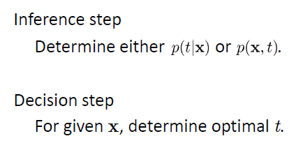
Decision Theory

Slide 46

Example : Medical diagnosis problem
Input: X-ray image of a patient
Input vector x is the set of pixel intensities in the image
Output: Presence of cancer = Class C1,
Absence of cancer, = Class C2.
Choose t to be a binary variable such that
t =0 corresponds to C1 and t =1 corresponds to C2.
We are interested in the probabilities of the two classes given the image, which are given by p(C_{k}|x).
Using Bayes’ theorem,

Slide 47
Minimum Misclassification Rate
Divide the input space into regions Rk called decision regions, one for each class, such that all points in Rk are assigned to class Ck
Boundaries between decision regions are called decision boundaries or decision surfaces
A mistake occurs when an input vector belonging to class C1 is assigned to class C2 or vice versa.

Slide 48
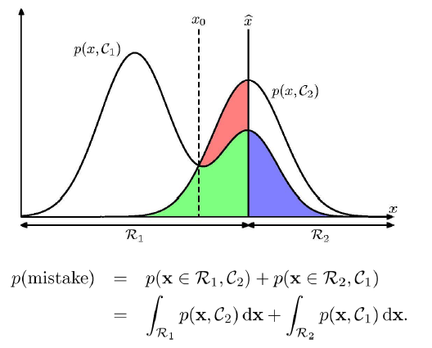
Minimum Misclassification Rate

Slide 49
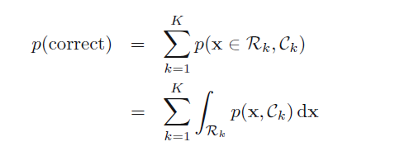
Minimum Misclassification Rate

Slide 50
Inference and Decision
We have broken the classification problem down into two separate stages, the inference stage in which we use training data to learn a model for p(C_{k}|x), and the subsequent decision stage in which we use these posterior probabilities to make optimal class assignments.
An alternative possibility would be to solve both problems together and simply learn a function that maps inputs x directly into decisions. Such a function is called a discriminant function.
Three distinct approaches to solving decision problems

Slide 51
Bayesian Learning
Bayesian learning algorithms that calculate explicit probabilities for hypotheses, such as the naive Bayes classifier, are among the most practical approaches to certain types of learning problems
For example: Problem of learning to classify text documents such as electronic news articles.
For such learning tasks, the naive Bayes classifier is among the most effective algorithms known

Slide 52
Features of Bayesian learning
Each observed training example can incrementally decrease or increase the estimated probability that a hypothesis is correct.
Flexible approach to learning than algorithms that completely eliminate a hypothesis if it is found to be inconsistent with any single example.
Bayesian methods can accommodate hypotheses that make probabilistic predictions (e.g., hypotheses such as "this pneumonia patient has a 93% chance of complete recovery").

Slide 53
Features of Bayesian learning
Prior knowledge can be combined with observed data to determine the final probability of a hypothesis.
Prior knowledge is provided by asserting
prior probability for each candidate hypothesis, and
probability distribution over observed data for each possible hypothesis.
New instances can be classified by combining the predictions of multiple hypotheses, weighted by their probabilities.

Slide 54
Machine Learning
Objective of ML: Given data X and target variable Y, determine the joint distribution P(X, Y)
Classification Problem
Decision boundary that separates one class from another class
Determine P(Y|X)
These models are called Deterministic
Or Discriminative modelss

Slide 55
Machine Learning
Alternate approach is to understand the process that generated the data
Generative Models P(X,Y)
Build a model for all the positive cases or category 1
Build another model for all the negative cases
or category 2
For predicting a new test case
Run the test case with both the models and choose the model with maximum probability

Slide 56
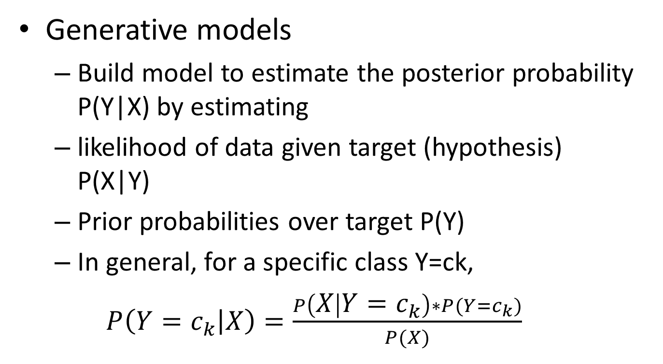
Machine Learning
Generative models
Build model to estimate the posterior probability P(Y|X) by estimating
likelihood of data given target (hypothesis) P(X|Y)
Prior probabilities over target P(Y)
In general, for a specific class Y=ck,
$P\left(Y=c_{k} | X\right)=\frac{P\left(X | Y=c_{k}\right)∗P(Y=c_{k})}{P(X)}$

Slide 57
Hypothesis
Relationship between the input and output values.
Lets say that target function y=f(x) However, f(.) is unknown function to us.
Machine learning algorithms try to guess a hypothesis function h(x) that approximates the unknown f(.)
Set of all possible hypotheses is known as the Hypothesis set or space H(.)
Goal is the learning process is to find the final hypothesis that best approximates the unknown target function.

Slide 58
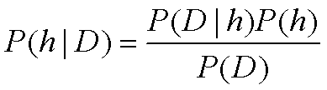
Bayes Theorem
P(h) = prior probability of hypothesis h
P(D) = prior probability of training data D
P(h|D) = probability of h given D
P(D|h) = probability of D given h

Slide 59
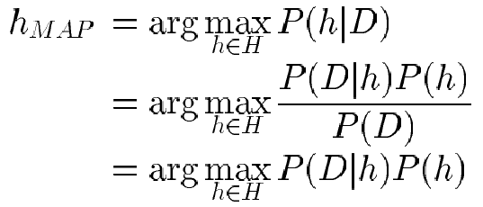

Choosing Hypotheses
Generally want the most probable hypothesis given the training data
Maximum a posteriori hypothesis h_{MAP}:
If assume P(h_{i}) = P(h_{j}) then can further simplify, and choose the Maximum likelihood (ML) hypothesis

Slide 60

Brute Force MAP Hypothesis
For each hypothesis h in H, calculate the posterior probability
Output the hypothesis h_{MAP} with the highest posterior probability

Slide 61
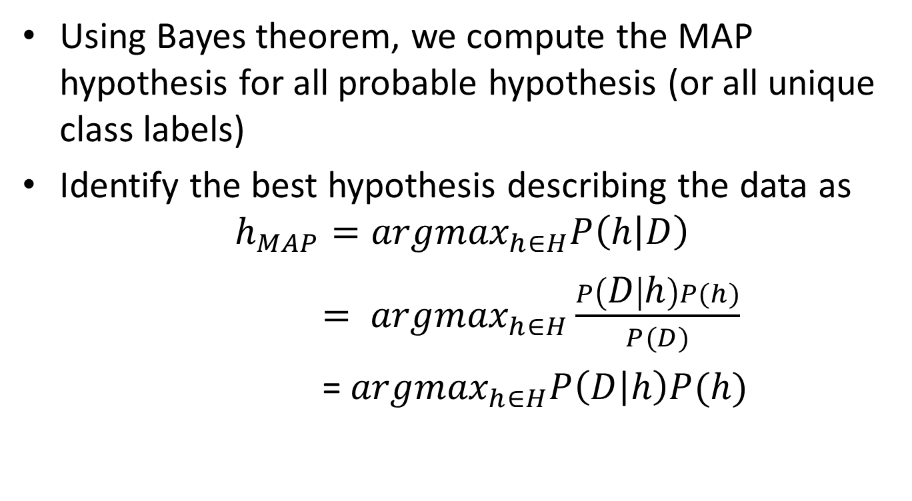
MAP Hypothesis
Using Bayes theorem, we compute the MAP hypothesis for all probable hypothesis (or all unique class labels)
Identify the best hypothesis describing the data as
$$h_{MAP}={argmax}_{h∈H}P\left(h | D\right)$$
$= {argmax}_{h∈H}\frac{P\left(D | h\right)P(h)}{P(D)}$
= ${argmax}_{h∈H}P\left(D | h\right)P(h)$
P(D) is independent of h and is same for all hypothesis, therefore dropped
H: set of all hypothesis

Slide 62
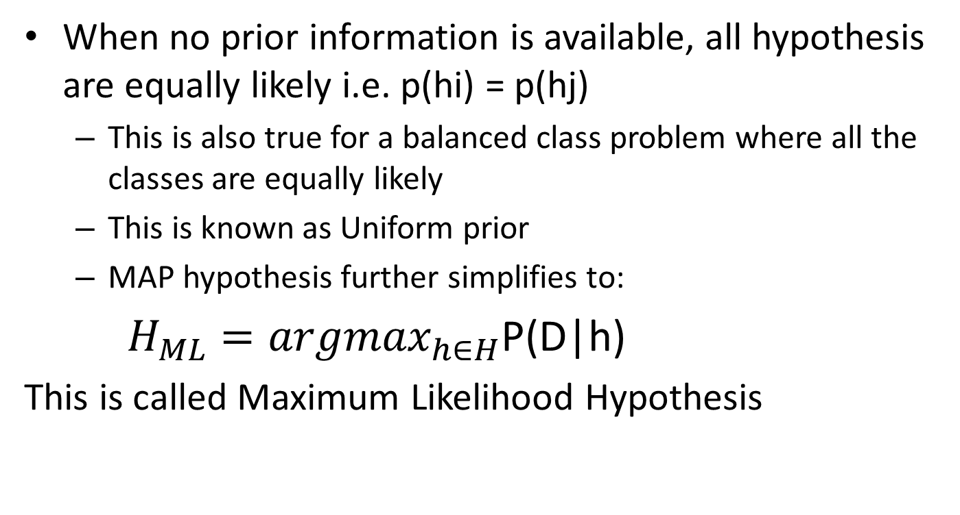
Maximum Likelihood estimation
When no prior information is available, all hypothesis are equally likely i.e. p(hi) = p(hj)
This is also true for a balanced class problem where all the classes are equally likely
This is known as Uniform prior
MAP hypothesis further simplifies to:
${H_{ML}=argmax}_{h∈H}$P(D|h)
This is called Maximum Likelihood Hypothesis

Slide 63
ML setting
Bayesian Analysis
start with some belief about the system, called a prior.
Then we obtain some data and use it to update our belief.
The outcome is called a posterior.
Should we obtain even more data, the old posterior becomes a new prior and the cycle repeats.
People often use likelihood for evaluation of models: a model that gives higher likelihood to real data is better

Slide 64
ML Setting
P(h | D) a posterior determines the class label
It’s a probability distribution over model parameters obtained from prior beliefs and data.
When one uses likelihood to get point estimates of model parameters, it’s called Maximum Likelihood estimation or MLE.
If one also takes the prior into account, then it’s maximum a posteriori estimation (MAP).
MLE and MAP are the same if the prior is uniform
This forms the basis for Naïve Bayes classifier

Slide 65
Relation to Concept Learning
Concept learning can be formulated as
problem of searching through a predefined space of potential hypotheses space H for the hypothesis that best fits the training examples D
consider the FindS learning algorithm (outputs most specific hypothesis from the version space V S_{H,D})
Does FindS output a MAP hypothesis??

Slide 66
Relation to Concept Learning
Assume fixed set of instances <x₁,…, x_{m}>
Assume D is the set of classifications: D = <c(x₁),…,c(x_{m})>
Choose P(D|h):
P(D|h) = 1 if h consistent with D
P(D|h) = 0 otherwise
Choose P(h) to be uniform distribution
P(h) = 1/|H| for all h in H

Slide 67
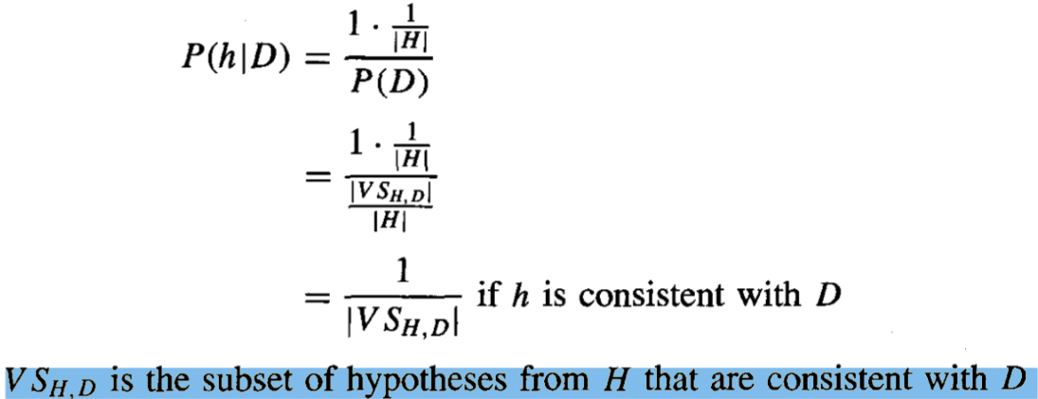
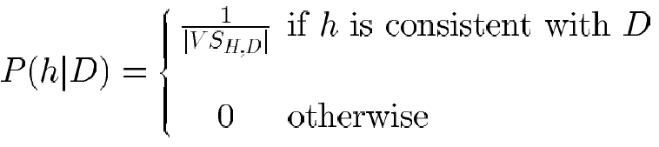
Relation to Concept Learning
P(h|D) = P(D|h)P(h) = 0 if h is inconsistent with D ie. P(D|h)=0)

Slide 68
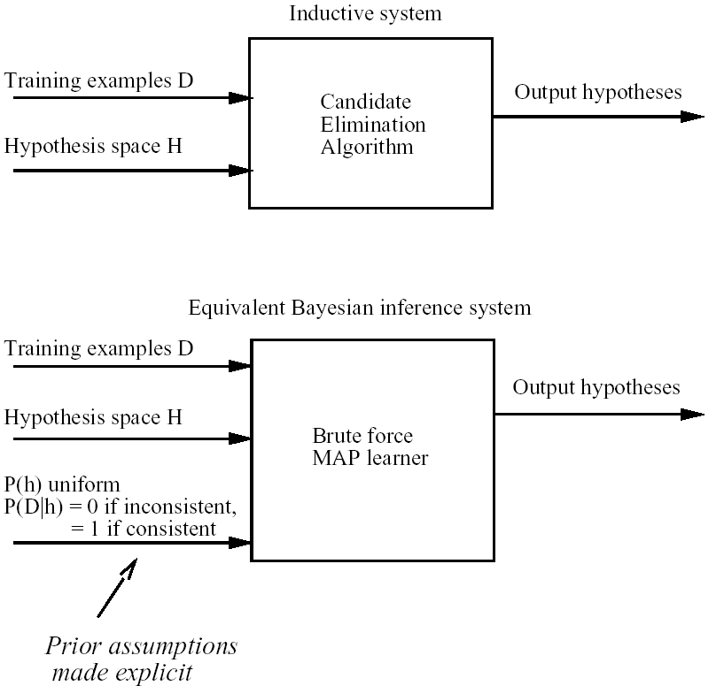
Characterizing Learning Algorithms by Equivalent MAP Learners

Slide 69
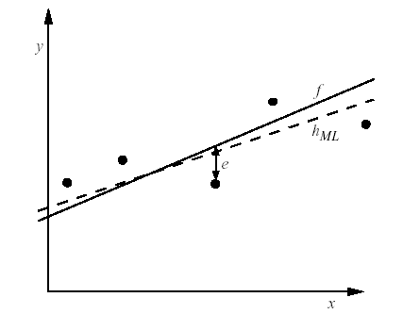

Learning A Real Valued Function
Consider any real-valued target function f
Training examples <x_{i}, d_{i}>, where d_{i} is noisy training value
d_{i} = f(x_{i}) + e_{i}
e_{i} is random variable (noise) drawn independently for each x_{i} according to some Gaussian distribution with mean=0
Then the maximum likelihood hypothesis h_{ML} is the one that minimizes
the sum of squared errors:

Slide 70
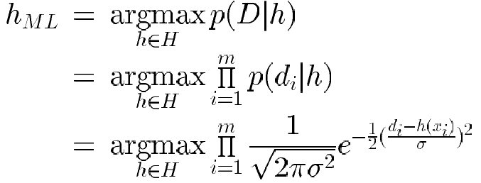
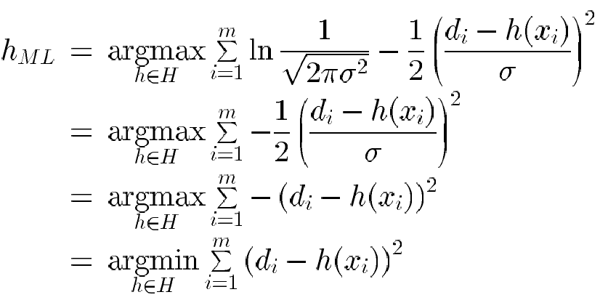
Learning A Real Valued Function
Maximize natural log of this instead...

Slide 71
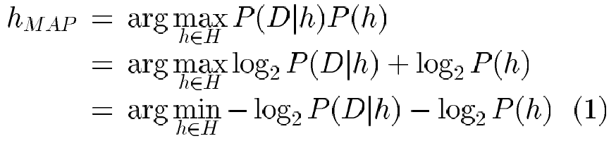
Minimum Description Length Principle
Interesting fact from information theory:
The optimal (shortest expected coding length) code for an event with
probability p is –log₂p bits.
So interpret (1):
L_{C1}(h) = length(h) = –log₂P(h)
L_{C2}(D|h)= length(misclassifications) = –log₂P(D|h)
→ prefer the hypothesis that minimizes
length(h) + length(misclassifications)

Slide 72

Minimum Description Length Principle
Occam’s razor: prefer the shortest hypothesis
MDL: prefer the hypothesis h that minimizes
where L_{C}(x) is the description length of x under encoding C
Example: H = decision trees hypothesis, D = training data labels
L_{C1}(h) is # bits to describe tree h
L_{C2}(D|h) is # bits to describe D given h
Note L_{C2}(D|h) = 0 if examples classified perfectly by h. Need only describe exceptions
Hence h_{MDL} trades off tree size for training errors

Slide 73
Minimum Description Length Principle
MDL principle provides a way of trading off hypothesis complexity for the number of errors committed by the hypothesis.
May select a shorter hypothesis that makes a few errors over a longer hypothesis that perfectly classifies the training data.
Provides one method for dealing with the issue of overfitting the data.

Slide 74
Most Probable Classification of New Instances
So far we’ve sought the most probable hypothesis given the data D (i.e., h_{MAP})
Given new instance x, what is its most probable classification?
h_{MAP}(x) is not the most probable classification!
Consider:
Three possible hypotheses:
P(h₁|D) = .4, P(h₂|D) = .3, P(h₃|D) = .3
Given new instance x,
h₁(x) = +, h₂(x) = −, h₃(x) = −
What’s most probable classification of x?

Slide 75

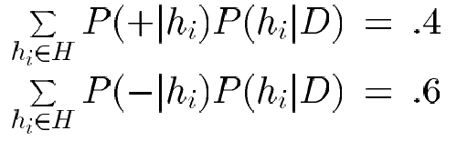

Bayes Optimal Classifier
Bayes optimal classification:
Example:
P(h₁|D) = .4, P(−|h₁) = 0, P(+|h₁) = 1
P(h₂|D) = .3, P(−|h₂) = 1, P(+|h₂) = 0
P(h₃|D) = .3, P(−|h₃) = 1, P(+|h₃) = 0
therefore
and

Slide 76
Gibbs Classifier
Bayes optimal classifier provides best result, but can be expensive if many hypotheses.
Gibbs algorithm:
1. Choose one hypothesis at random, according to P(h|D)
2. Use this to classify new instance
Surprising fact: Assume target concepts are drawn at random from H according to priors on H. Then:
E[error_{Gibbs}] ≤ 2E [error_{BayesOptional}]
Suppose correct, uniform prior distribution over H, then
Pick any hypothesis from VS, with uniform probability
Its expected error no worse than twice Bayes optimal

Slide 77
Practical Issues of Bayesian learning
Require initial knowledge of many probabilities
Often estimated based on background knowledge, previously available data, and assumptions about the form of the underlying distributions.
Significant computational cost required to determine the Bayes optimal hypothesis in the general case (linear in the number of candidate hypotheses)

Slide 78
References
https://www.youtube.com/watch?v=E3l26bTdtxI

